Slide 1

FPT University
Android programMing
Lesson 8
Version 1.0

Slide 2
Agenda
Floating Action Button and Snackbar
Creating a Tabbed Interface using the TabLayout Component
Working with the RecyclerView and CardView Widgets

Slide 3
Floating Action Button and Snackbar
The Material Design
Material design make up the user interface of Android and the apps that run on it appear and behave in a certain way in terms of behavior, shadowing, animation and styles
elements of a user interface appear to have physical depth and a sense that items are constructed in layers of physical material

Slide 4
Floating Action Button and Snackbar
The Design Library Many of the building blocks needed to implement Android applications that adopt the principles of material design are contained within the Android Design Support Library. This library contains a collection of user interface components that can be included in Android applications to implement much of the look, feel and behavior of material design

Slide 5
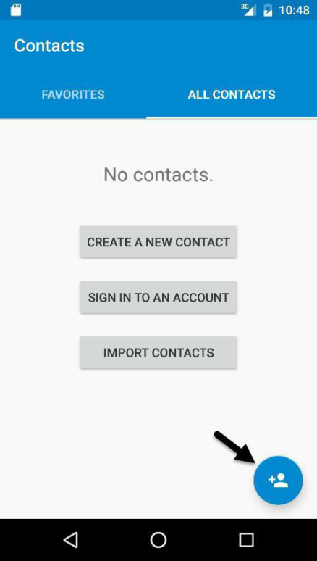
Floating Action Button and Snackbar
The Floating Action Button (FAB) There are a number of rules that should be followed when using floating action buttons
Must be circular
56 x 56dp (Default) or 40 x 40dp (Mini) in size
Minimum of 16dp the edge of the screen on phones and 24dp on desktops and tablet devices
icon is 24x24dp in size
Notes:
pt – Points (1/72 of an inch). dp – Density-independent pixels. An abstract unit of measurement based on the physical density of the device display relative to a 160dpi display baseline. sp – Scale-independent pixels. Similar to dp but scaled based on the user’s font preference. px – Actual screen pixels. Use is not recommended since different displays will have different pixels per inch. Use dp in preference to this unit

Slide 6
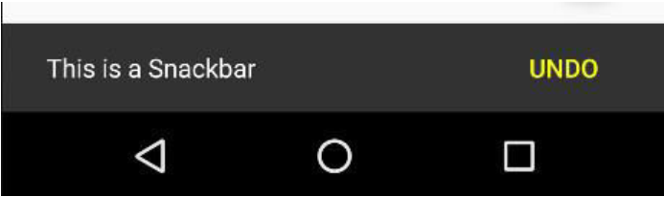
Floating Action Button and Snackbar
The Snackbar The Snackbar component provides a way to present the user with information in the form of a panel that appears at the bottom of the screen

Slide 7
Floating Action Button and Snackbar
Creating the Example Project - FAB can be added manually but it is much easier to use the Basic Activity template
<android.support.design.widget.FloatingActionButton android:id="@+id/fab" android:layout_width="wrap_content" android:layout_height="wrap_content" android:layout_gravity="bottom|end" android:layout_margin="@dimen/fab_margin" app:srcCompat="@android:drawable/ic_dialog_email" />

Slide 8
Floating Action Button and Snackbar
Changing the Floating Action Button
Icon
Background color
Size

Slide 9
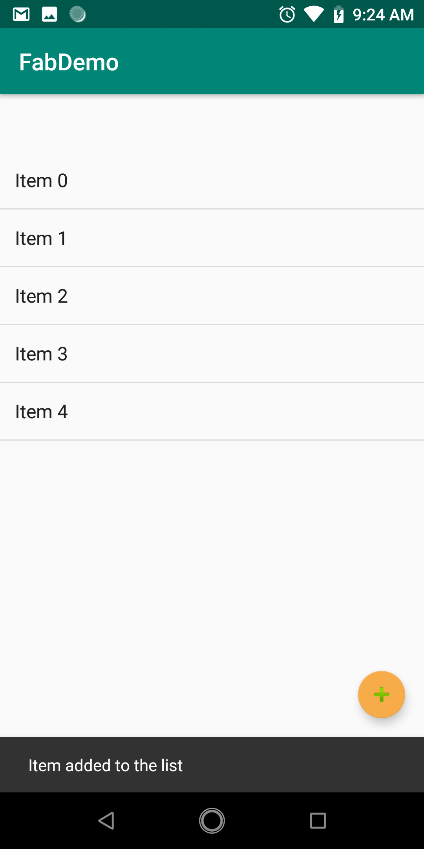
Floating Action Button and Snackbar
Handle event for FAB
private ListView listView; private ArrayList<String> items; private ArrayAdapter<String> adapter;

Slide 10
Floating Action Button and Snackbar
Handle event for FAB
items = new ArrayList(); listView = findViewById(R.id.listView); adapter = new ArrayAdapter<String>(this, android.R.layout.simple_list_item_1, items); listView.setAdapter(adapter); FloatingActionButton fab = (FloatingActionButton) findViewById(R.id.fab); fab.setOnClickListener(new View.OnClickListener() { @Override public void onClick(View view) { addListItem(); Snackbar.make(view, "Item added to the list", Snackbar.LENGTH_LONG) .setAction("Action", null).show(); } });
public void addListItem(){ items.add("Item " + items.size()); adapter.notifyDataSetChanged(); }

Slide 11
Floating Action Button and Snackbar
Adding an Action to the Snackbar
fab.setOnClickListener(new View.OnClickListener() { @Override public void onClick(View view) { addListItem(); Snackbar.make(view, "Item added to the list", Snackbar.LENGTH_LONG) .setAction("Undo", undoOnClickListener).show(); } });
View.OnClickListener undoOnClickListener = new View.OnClickListener() { @Override public void onClick(View view) { items.remove(items.size() -1); adapter.notifyDataSetChanged(); Snackbar.make(view, "Item removed", Snackbar.LENGTH_LONG) .setAction("Action", null).show(); } };

Slide 12
Creating a Tabbed Interface using the TabLayout Component
An Introduction to the ViewPager The primary role of the ViewPager is to allow the user to flip through different pages of information where each page is most typically represented by a layout fragment

Slide 13

Creating a Tabbed Interface using the TabLayout Component
An Overview of the TabLayout Component The purpose of the TabLayout is to present the user witha row of tabs which can be selected to display different pages to the user

Slide 14
Creating a Tabbed Interface using the TabLayout Component
Creating the TabLayoutDemo
<android.support.design.widget.TabLayout android:id="@+id/tab_layout" android:layout_width="match_parent" android:layout_height="wrap_content" app:tabGravity="fill" app:tabMode="fixed" />
<android.support.v4.view.ViewPager android:id="@+id/pager" android:layout_width="match_parent" android:layout_height="match_parent" app:layout_behavior="@string/appbar_scrolling_view_behavior" />

Slide 15
Creating a Tabbed Interface using the TabLayout Component
public class TabPagerAdapter extends FragmentPagerAdapter { int tabCount; public TabPagerAdapter(FragmentManager fm, int numberOfTabs) { super(fm); this.tabCount = numberOfTabs; } @Override public Fragment getItem(int position) { switch (position) { case 0: FragmentTab1 tab1 = new FragmentTab1(); return tab1; case 1: FragmentTab2 tab2 = new FragmentTab2(); return tab2; case 2: FragmentTab3 tab3 = new FragmentTab3(); return tab3; case 3: FragmentTab4 tab4 = new FragmentTab4(); return tab4; default: return null; } } @Override public int getCount() { return tabCount; } }

Slide 16
Creating a Tabbed Interface using the TabLayout Component
Adding tabs to main layout
TabLayout tabLayout = (TabLayout) findViewById(R.id.tab_layout); tabLayout.addTab(tabLayout.newTab().setText("Tab 1 Item")); tabLayout.addTab(tabLayout.newTab().setText("Tab 2 Item")); tabLayout.addTab(tabLayout.newTab().setText("Tab 3 Item")); tabLayout.addTab(tabLayout.newTab().setText("Tab 4 Item"));

Slide 17
Creating a Tabbed Interface using the TabLayout Component
Adding tabs to main layout

Slide 18
Creating a Tabbed Interface using the TabLayout Component
Performing the Initialization Tasks
final ViewPager viewPager = (ViewPager) findViewById(R.id.pager); final PagerAdapter adapter = new TabPagerAdapter (getSupportFragmentManager(), tabLayout.getTabCount()); viewPager.setAdapter(adapter); viewPager.addOnPageChangeListener(new TabLayout.TabLayoutOnPageChangeListener(tabLayout)); tabLayout.addOnTabSelectedListener(new TabLayout.OnTabSelectedListener() { @Override public void onTabSelected(TabLayout.Tab tab) { viewPager.setCurrentItem(tab.getPosition()); } @Override public void onTabUnselected(TabLayout.Tab tab) { } @Override public void onTabReselected(TabLayout.Tab tab) { } });
Notes:
public class TabLayoutDemo extends AppCompatActivity implements FragmentTab1.OnFragmentInteractionListener, FragmentTab2.OnFragmentInteractionListener,FragmentTab3.OnFragmentInteractionListener, FragmentTab4.OnFragmentInteractionListener{

Slide 19
Creating a Tabbed Interface using the TabLayout Component
Using scroll in TabLayout
<android.support.design.widget.TabLayout android:id="@+id/tab_layout" android:layout_width="match_parent" android:layout_height="wrap_content" app:tabGravity="fill" app:tabMode="scrollable" />

Slide 20
Creating a Tabbed Interface using the TabLayout Component
Using icon
tabLayout.addTab(tabLayout.newTab().
setIcon(android.R.drawable.ic_dialog_email));

Slide 21
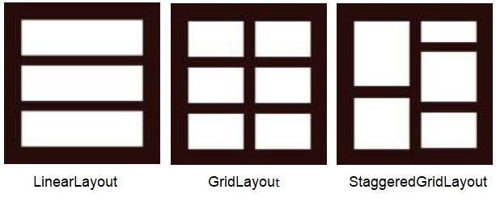
Working with the RecyclerView and CardView Widgets
An Overview of the RecyclerView - Like listView provides a number of advantages over the ListView - RecyclerView provides a choice of three built-in layout

Slide 22
Working with the RecyclerView and CardView Widgets
RecyclerView using an adapter to work with dataset. The adapter is created as a subclass of the RecyclerView.Adapter class and must implements three methods
- getItemCount() - onCreateViewHolder()
- onBindViewHolder()

Slide 23
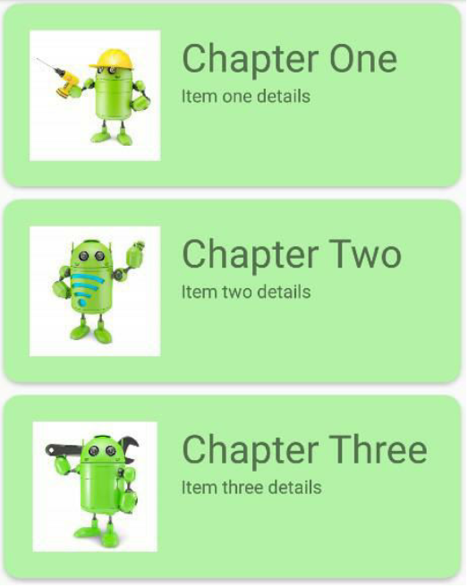
Working with the RecyclerView and CardView Widgets
An Overview of the CardView The CardView class is a user interface view that allows information to be presented in groups using a card metaphor. Cards are usually presented in lists using a RecyclerView instance .

Slide 24
Working with the RecyclerView and CardView Widgets
Create demo project
<android.support.v7.widget.RecyclerView android:id="@+id/recycler_view" android:layout_width="match_parent" android:layout_height="match_parent" android:layout_marginStart="8dp" android:layout_marginTop="8dp" android:layout_marginEnd="8dp" android:layout_marginBottom="8dp" app:layout_behavior="@string/appbar_scrolling_view_behavior" app:layout_constraintBottom_toBottomOf="parent" app:layout_constraintEnd_toEndOf="parent" app:layout_constraintStart_toStartOf="parent" app:layout_constraintTop_toTopOf="parent" />

Slide 25
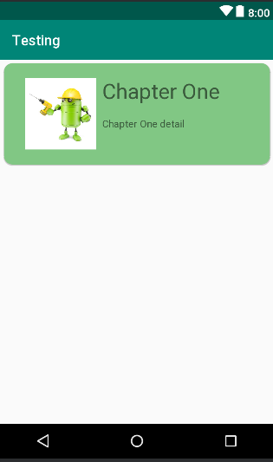
Working with the RecyclerView and CardView Widgets
Designing the CardView Layout
Notes:
<?xml version="1.0" encoding="utf-8"?> <android.support.v7.widget.CardView xmlns:android="http://schemas.android.com/apk/res/android" xmlns:card_view="http://schemas.android.com/apk/res-auto" android:layout_width="match_parent" android:layout_height="wrap_content" android:id="@+id/card_view" android:layout_margin="5dp" card_view:cardBackgroundColor="#81C784" card_view:cardCornerRadius="12dp" card_view:cardElevation="3dp" card_view:contentPadding="4dp" >
<RelativeLayout android:layout_width="match_parent" android:layout_height="wrap_content" android:padding="16dp" >
<ImageView android:layout_width="100dp" android:layout_height="100dp" android:id="@+id/item_image" android:layout_alignParentStart="true" android:layout_alignParentLeft="true" android:layout_alignParentTop="true" android:layout_marginEnd="16dp" android:layout_marginRight="16dp" />
<TextView android:layout_width="wrap_content" android:layout_height="wrap_content" android:id="@+id/item_title" android:layout_toEndOf="@+id/item_image" android:layout_toRightOf="@+id/item_image" android:layout_alignParentTop="true" android:textSize="30sp" />
<TextView android:layout_width="wrap_content" android:layout_height="wrap_content" android:id="@+id/item_detail" android:layout_toEndOf="@+id/item_image" android:layout_toRightOf="@+id/item_image" android:layout_below="@+id/item_title" /> </RelativeLayout>
</android.support.v7.widget.CardView>

Slide 26
Working with the RecyclerView and CardView Widgets
Creating the RecyclerView Adapter
public class RecyclerAdapter extends RecyclerView.Adapter<RecyclerAdapter.ViewHolder> { @NonNull @Override public ViewHolder onCreateViewHolder(ViewGroup viewGroup, int i) { View v = LayoutInflater.from(viewGroup.getContext()) .inflate(R.layout.card_layout, viewGroup, false); ViewHolder viewHolder = new ViewHolder(v); return viewHolder; } @Override public void onBindViewHolder(ViewHolder viewHolder, int i) { viewHolder.itemTitle.setText(titles[i]); viewHolder.itemDetail.setText(details[i]); viewHolder.itemImage.setImageResource(images[i]); } @Override public int getItemCount() { return titles.length; }

Slide 27
Working with the RecyclerView and CardView Widgets
Prepairing data
private String[] titles = {"Chapter One", "Chapter Two", "Chapter Three", "Chapter Four", "Chapter Five", "Chapter Six", "Chapter Seven", "Chapter Eight"}; private String[] details = {"Item one details", "Item two details", "Item three details", "Item four details", "Item file details", "Item six details", "Item seven details", "Item eight details"}; private int[] images = { R.drawable.android_image_1, R.drawable.android_image_2, R.drawable.android_image_3, R.drawable.android_image_4, R.drawable.android_image_5, R.drawable.android_image_6, R.drawable.android_image_7, R.drawable.android_image_8 };

Slide 28
Working with the RecyclerView and CardView Widgets
Creating ViewHolder Class
class ViewHolder extends RecyclerView.ViewHolder { public ImageView itemImage; public TextView itemTitle; public TextView itemDetail; public ViewHolder(View itemView) { super(itemView); itemImage = (ImageView)itemView.findViewById(R.id.item_image); itemTitle = (TextView)itemView.findViewById(R.id.item_title); itemDetail = (TextView)itemView.findViewById(R.id.item_detail); } }

Slide 29
Working with the RecyclerView and CardView Widgets
Setting adapter
public class RecyclerViewDemo extends AppCompatActivity { RecyclerView recyclerView; RecyclerView.LayoutManager layoutManager; RecyclerView.Adapter adapter; @Override protected void onCreate(Bundle savedInstanceState) { super.onCreate(savedInstanceState); setContentView(R.layout.activity_recycler_view_demo); recyclerView = (RecyclerView) findViewById(R.id.recycler_view); layoutManager = new LinearLayoutManager(this); recyclerView.setLayoutManager(layoutManager); adapter = new RecyclerAdapter(); recyclerView.setAdapter(adapter); } }

Slide 30
Working with the RecyclerView and CardView Widgets
Responding to Card Selections
itemView.setOnClickListener(new View.OnClickListener() { @Override public void onClick(View v) { int position = getAdapterPosition(); Snackbar.make(v, "Click detected on item " + titles[position], Snackbar.LENGTH_LONG) .setAction("Action", null).show(); } });

Slide 31

End of Lesson 8

Slide 32
Thank you!

